Slide 1
1.3 Variables and Data Types

Slide 2
Variables
A name associated with a memory location in the computer where you can store a value that can change or vary.

Slide 3
Variable Types in Java
There are two types of variables in Java:
Primitive variables: These hold primitive data types like integers, doubles, and booleans.
Object or Reference variables: These hold reference to an object of a class. For example, strings. A reference is a way to find the object (like the tracking number on a package).

Slide 4
Primitive Data Types in Java
Byte (1byte): Store whole numbers from -128 to 127
Short (2bytes): Store whole numbers from -32,768 to 32,767
Integer (4bytes): Store whole numbers from -2,147,483,648 to 2,147,483,647
Float (4bytes): Stores fractional numbers. Sufficient for storing 6 to 7 decimal digits
Double (8bytes): Stores fractional numbers. Sufficient for storing 15 decimal digits
Long (8bytes): Store whole numbers -9,223,372,036,854,775,808 to 9,223,372,036,854,775,807
Boolean (1bit): Stores true or false values
Char (2bytes): Stores a single character/letter

Slide 5
Declaring Variables in Java
To create variables you need its data type and name. This is called declaring a variable.
Syntax:
type variableName;
*notice lowercase type, camelCase name, semicolon at the end

Slide 6
Declaring and Assigning Variables in Java
You can declare AND assign variables.
Syntax:
type variableName = value;
*notice lowercase type, camelCase name, equal sign to assign value, semicolon at the end

Slide 7
Integer: int myInt = 31;
Float: float myFloatNum = 5.99f;
Double: double myDouble = 5.5;
Boolean: bool myBool = true;
Char: char myletter = ‘M’;

Slide 8
Assignment Operator
Unlike in math, ‘=’ does not mean both sides are equal to each other. It means set the value in the memory location associated to the variable on the left to a copy of the value on the right.
We can change the value of a variable by assigning it a different value.

Slide 9
EX:
int myInt = 10;
System.out.println(myInt);
myInt = 5;
System.out.println(myInt);
We are assigning the value 10 in the memory location for myInt.
We then change the value to 5.
Console output:
10
5

Slide 10
Keyword Final
The keyword final can be used in front of a variable declaration to make it a constant that cannot be changed. Constants are traditionally capitalized.
Syntax:
final type NAME = value;
EX:
final double PI = 3.14;

Slide 11
Naming your Variables
You can give variables *almost* any name. Names must start with a lowercase letter and can include letters, numbers, underscores. It must all be one word with no spaces, camelCase to easily read longer names. Names should describe the data it holds, keep it short and sweet. You want your code to be easy to understand.
*keywords are off limits (for, if, class, double, static, int, …etc)

Slide 12
The String Concatenation Operator (+)
Same symbol as addition
Used to combine strings and other data types into strings
EX.
System.out.print("hello " + " friend");
Will print out: hello friend
System.out.print("your score: " + 100)
Will print out: your score: 100

Slide 13
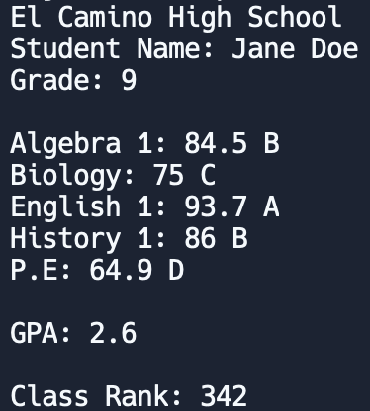
Lets Practice!
On Repl.it: studentTranscript
Write a program that stores the student information. Then prints all information like a transcript. USE COMMENTS in your code!
Algebra 1 | 84.5 | El Camino High School
Biology | 75 | Jane Doe
English 1 | 93.7 | Grade 9
History 1 | 86 | GPA: 2.6
P.E | 64.9 | Class rank: 342

